Slide 1


High School Senior Survey – What’s Next
Results of the 2017 Mt. Hood Community College District
High School Senior Survey – Springwater Trail Version
Prepared by: Tim Green
Research Associate
Analytics & Institutional Research
Mt. Hood Community College

Slide 2
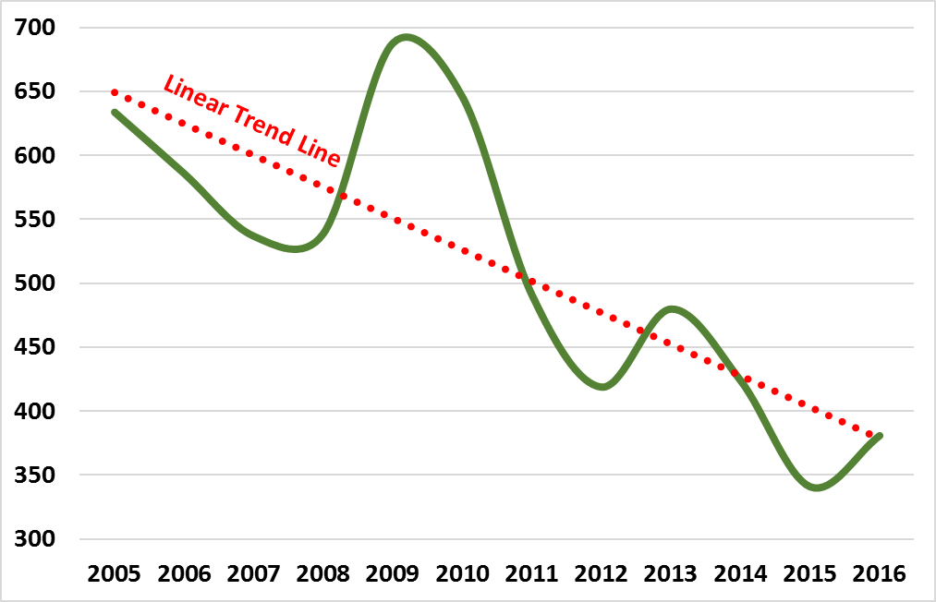
Purpose of the Study
Decline in High School Seniors attending MHCC.
Research Question:
What are in-district high school seniors planning on doing once they receive their high school diploma?
MHCC Strategic Plan:
Strategic Priority –
Establish and maintain relationships with school districts to encourage on-going educational goals.
Notes:
Figure Corresponds to a 46% Drop in High School Senior Enrollment at MHCC.

Slide 3
Methodology
Study Introduced
Survey Development
Data Collection
AIR email to Principals
On-line survey with unique URL for each school
Each School has custom questions
Senior exit interview process
Data collection from May through June
Analysis & Reporting
Data Analyzed by MHCC Research Associate
Deliverables:
Final Report
Research Brief
Presentation
Raw Data (on request)
AIR meets with new principals to discuss study and methodology
Notes:
AIR representatives contacted via email all in-district high school principals.
Survey developed with unique URL for each high school. The URL allowed students to be tagged to their high school automatically. Also allowed for specific questions to be asked by high school.
The previous administration of the study proved that capturing the data during the senior exit interview process (all seniors go through a process before graduation), was the most effective time to gather the data and would maximize completion rates.

Slide 4
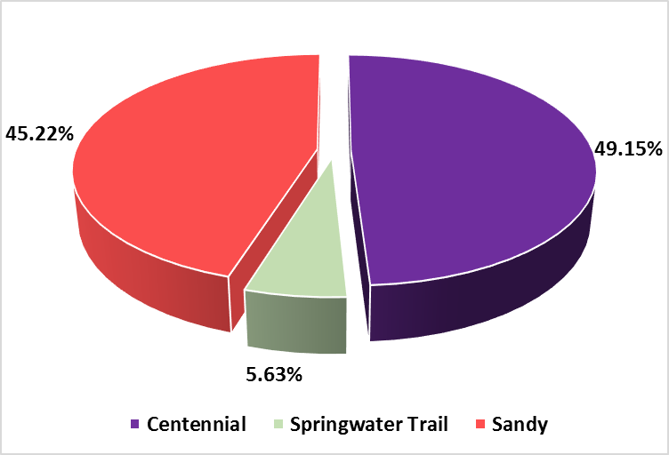
Who Responded?
Notes:
Roughly equal proportions for the Centennial and Sandy HS. Springwater Trail is a substantially smaller high school; the proportion from Springwater Trail was expected to be smaller. Information regarding the number of graduating seniors from each school is not available.

Slide 5
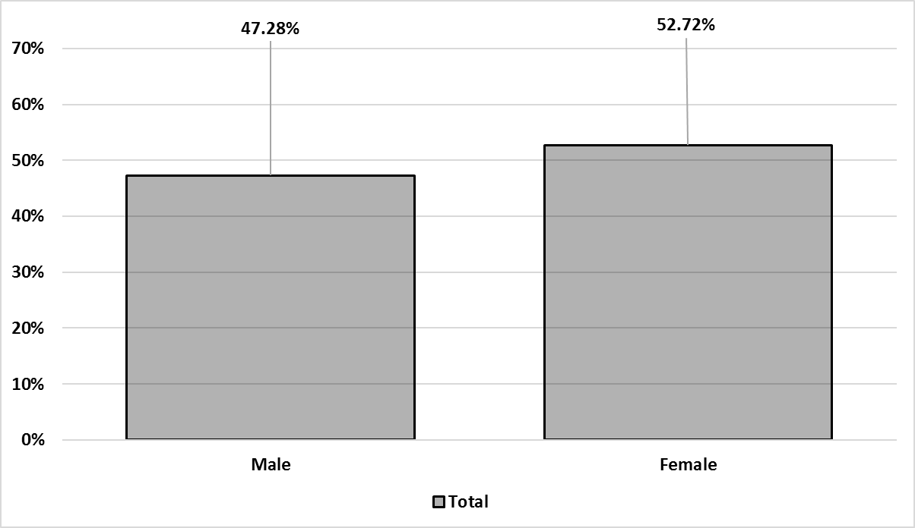
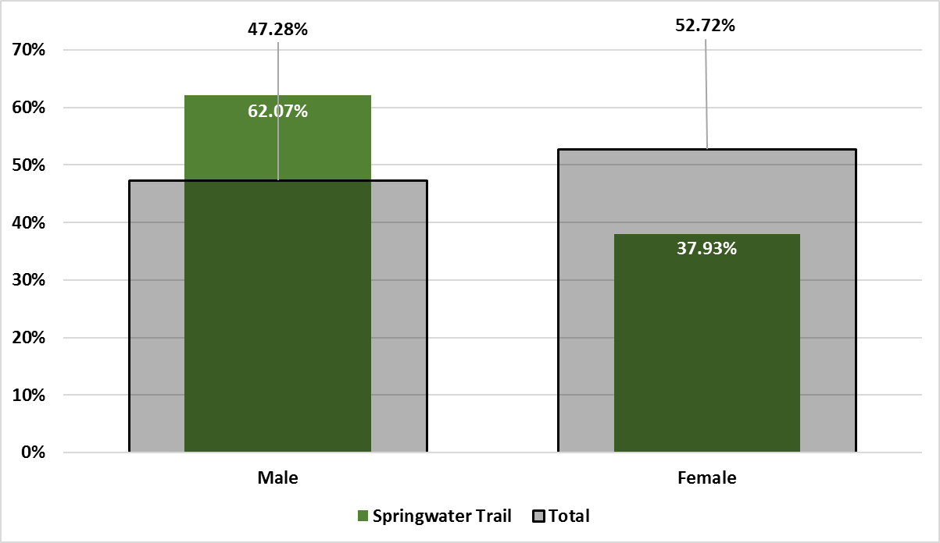
Who Responded - Gender
Notes:
Similar proportions of females and males.
Springwater Trail – Higher proportion of males

Slide 6
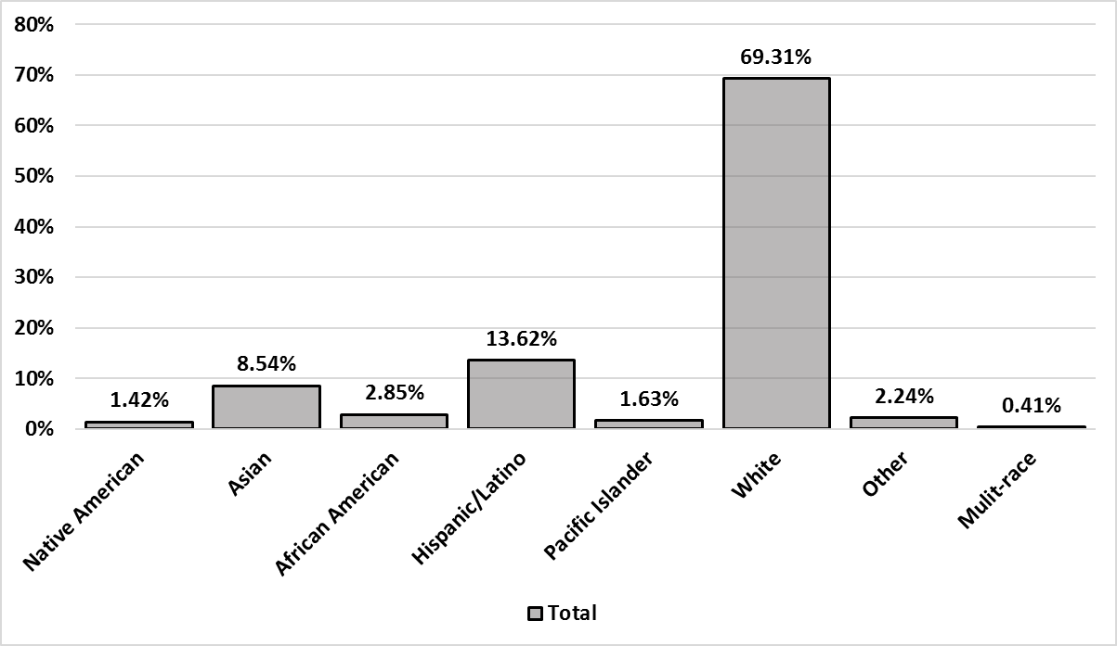
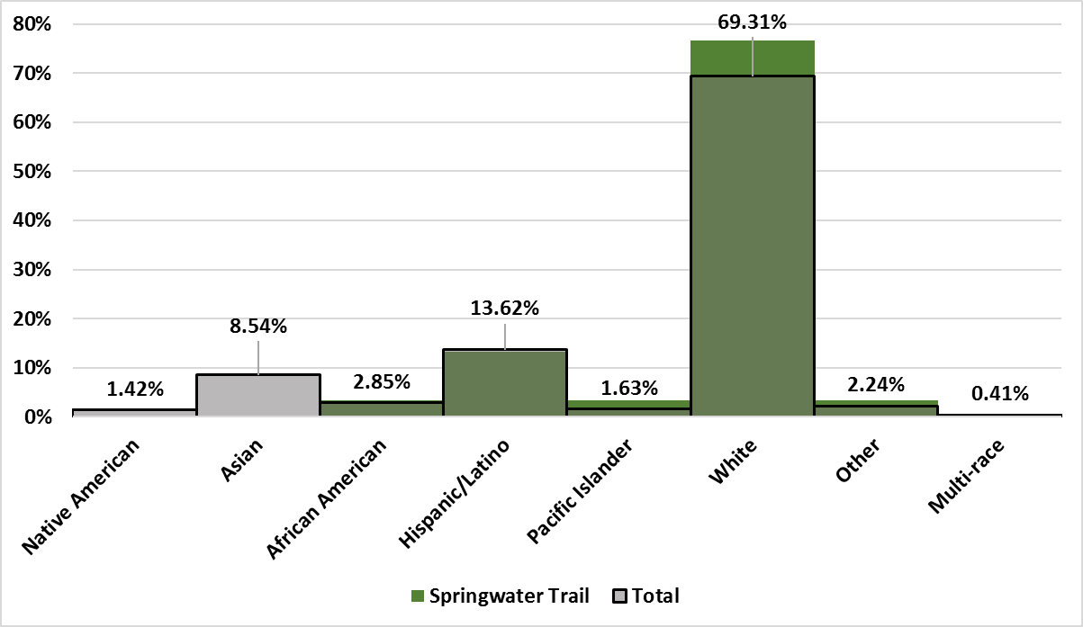
Who Responded – Race/Ethnicity
Notes:
Total Respondents about equal to proportions within the district population
Springwater Trail – Higher proportions of Hispanic/Latino and White

Slide 7
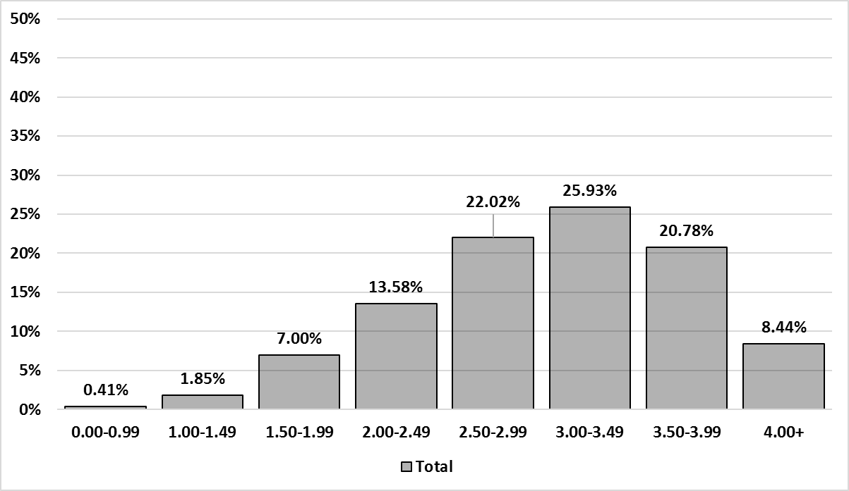
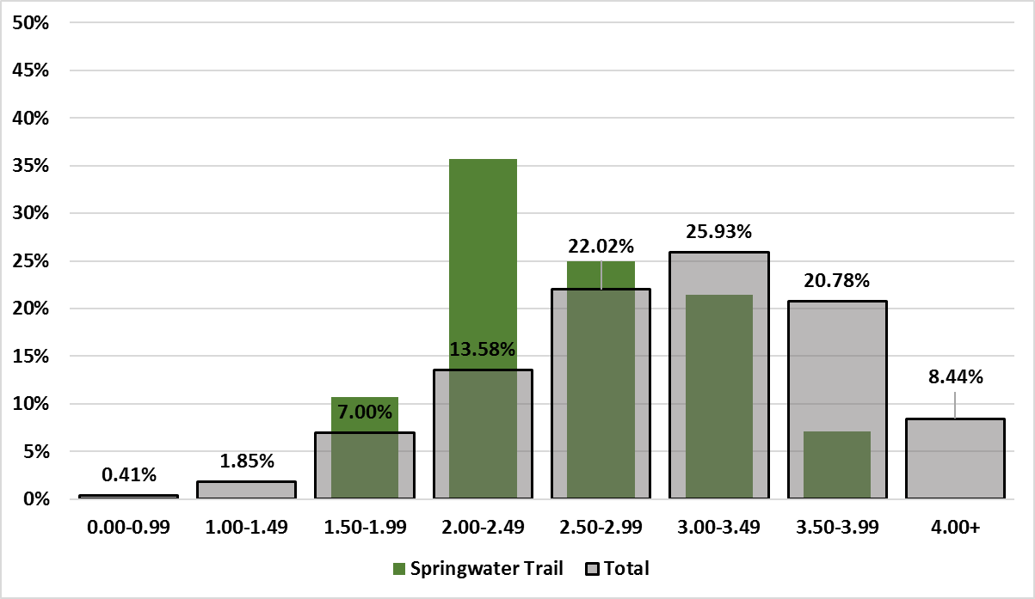
Who Responded –
Grade Point Average
Notes:
Total Proportions very symmetrical curve.
Springwater Trail – Much Higher proportions of students reporting 2.00-2.49 GPA higher proportion reporting 2.50-2.99 GPA.

Slide 8
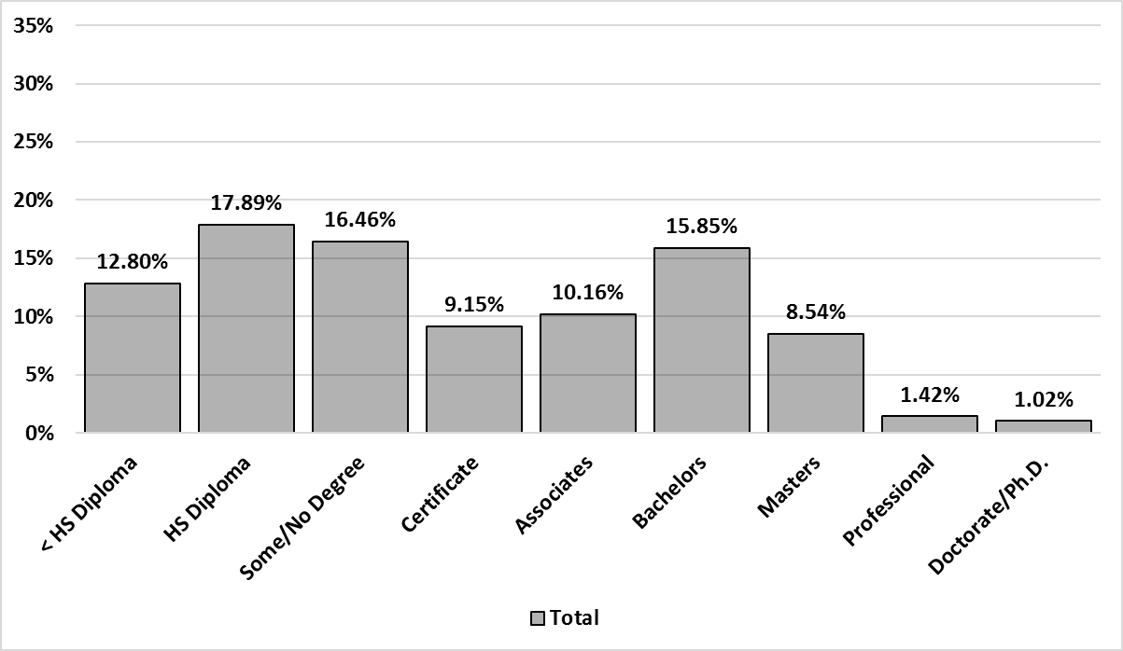
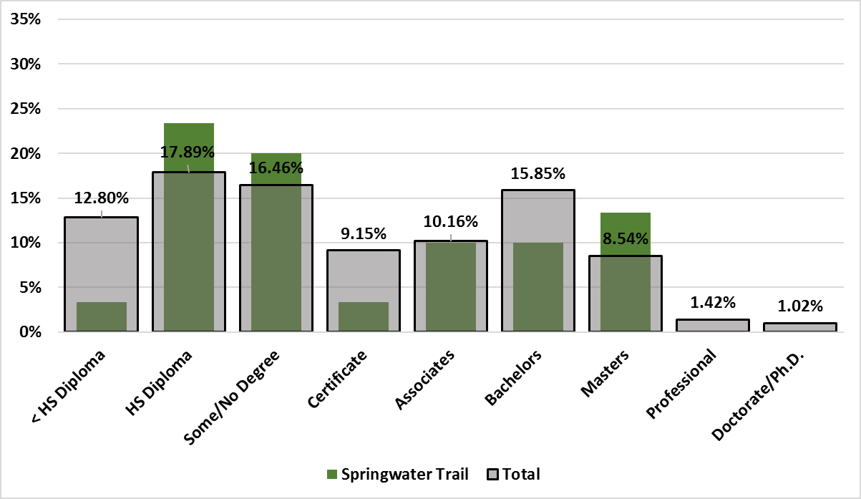
Who Responded –
Parent’s Education
Level
Notes:
Question asked for two parent’s education level. Analysis looked at both and returned highest education.
For all schools: Highest proportion had at least one parent earning a High School Diploma
Second highest proportion: Bachelors Degree
Springwater: Higher proportions reporting HS Diploma, Some College/No Degree, and Masters.
Lower proportion reporting Certificate or Bachelors.

Slide 9
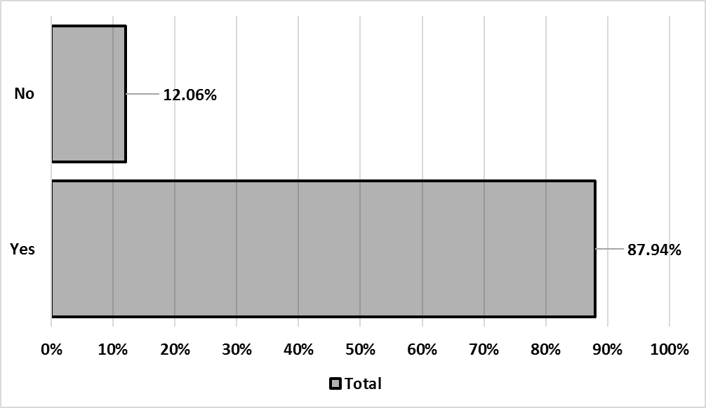
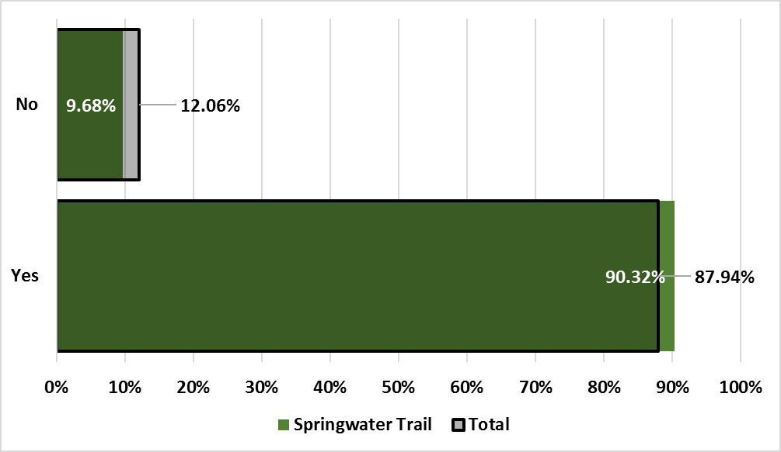
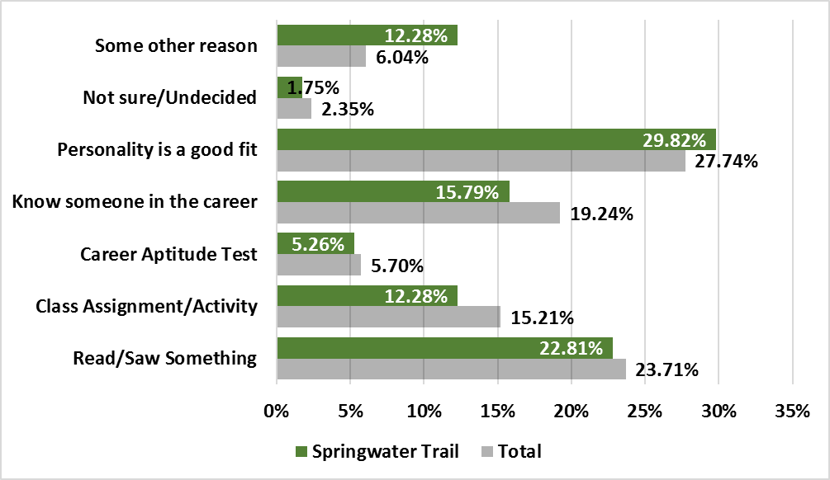
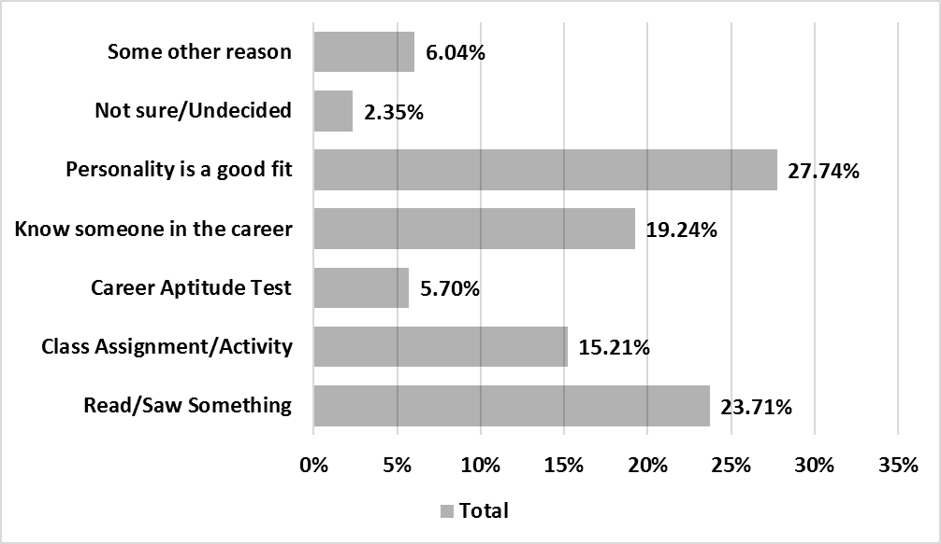
Career Questions
I can name a career I’m interested in pursuing.
How did you decide that career was a good fit?
Notes:
88% of Seniors surveyed have some idea of the career they’d like to pursue.
The majority believe the career identified is a good fit with their personality

Slide 10
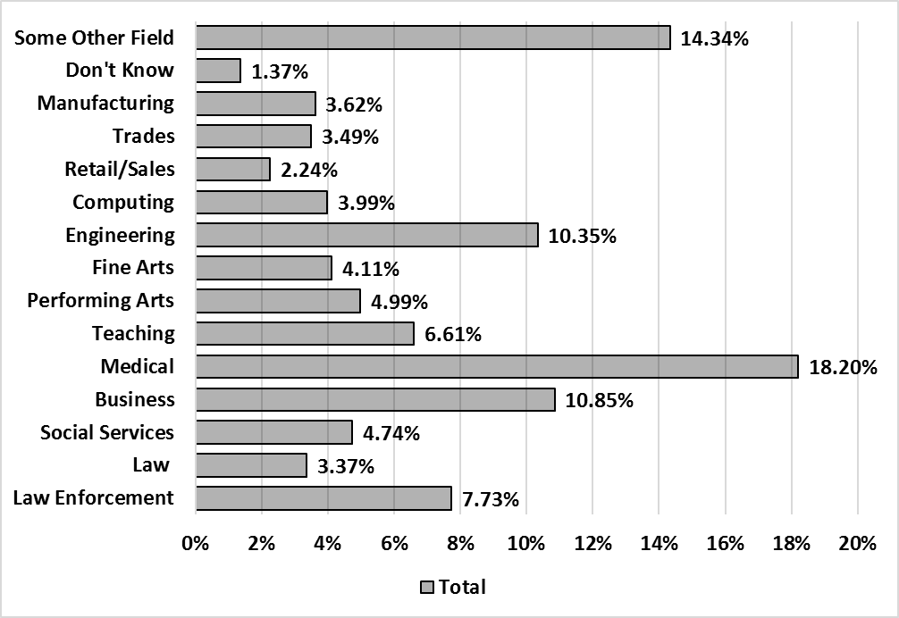
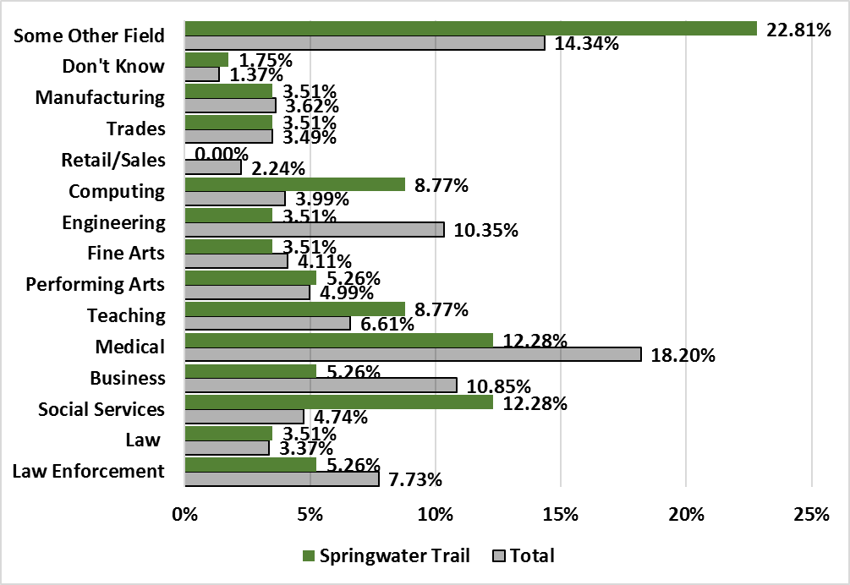
Career Questions
What field or fields are you interested in?
Notes:
When asked about the career area:
Medical Field was most often identified
Business was second most often
Engineering was third
Springwater: More likely to identify Social Services, Computing, or Teaching Fields

Slide 11
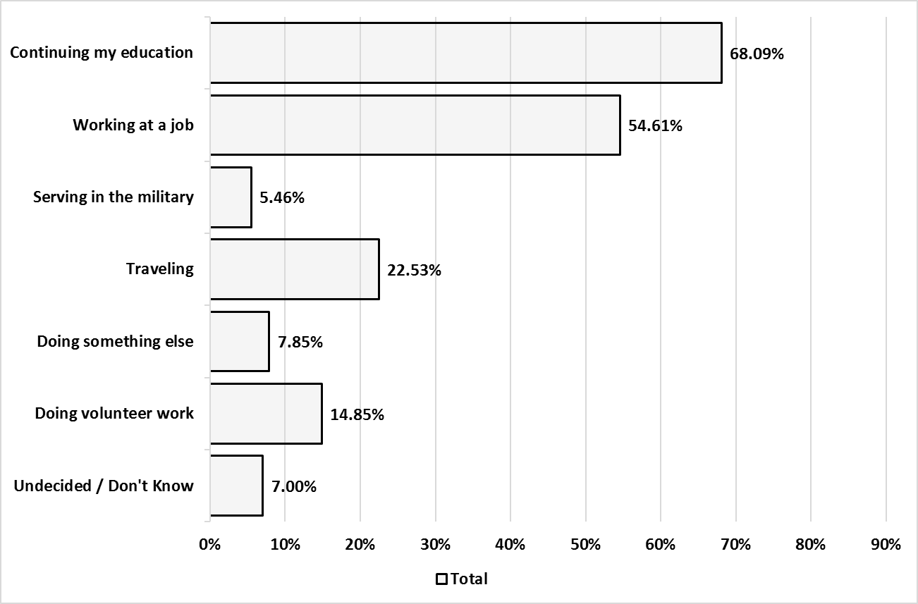
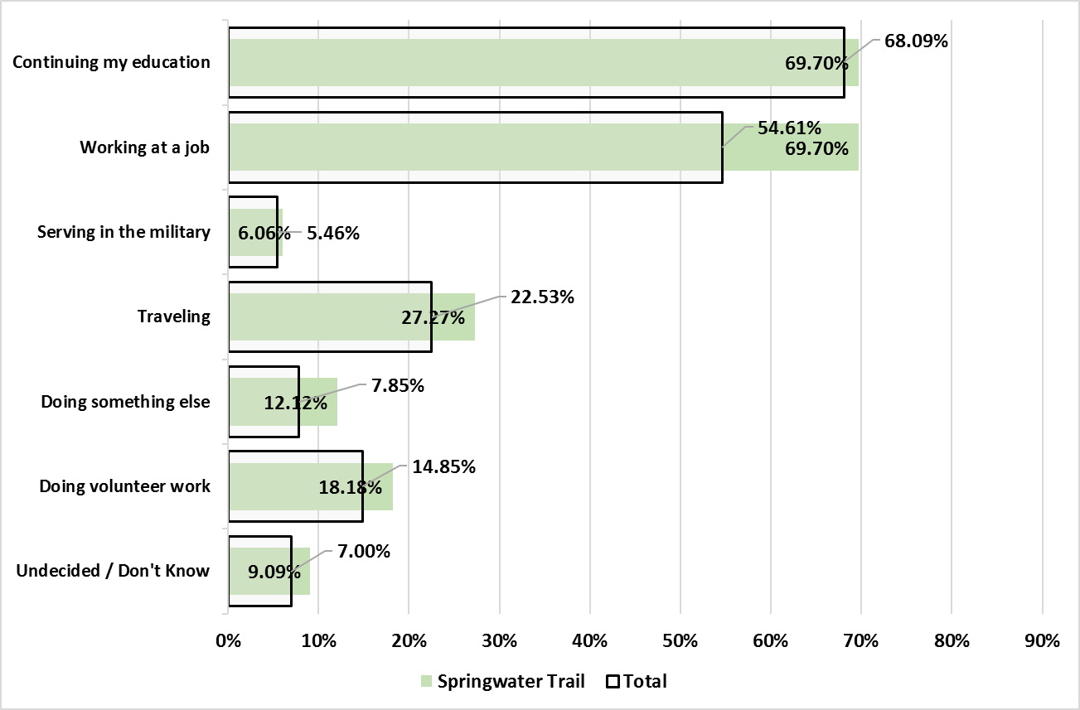
Results –
Future Plans
Notes:
Over 2/3’s of Seniors surveyed indicated they would be continuing their education.
Springwater: Higher proportion will be doing all activities identified. Much higher proportions doing something else
or working.

Slide 12
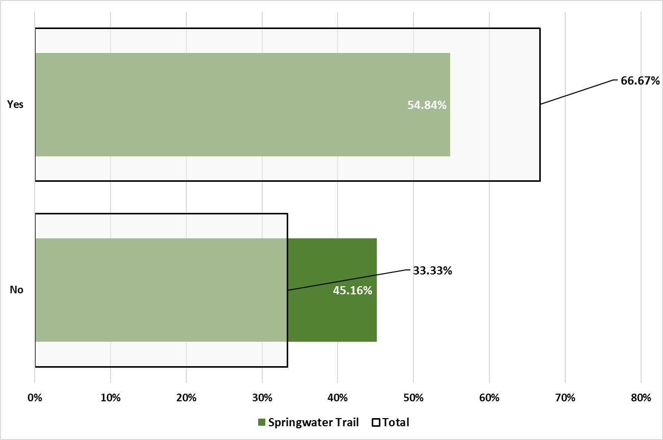
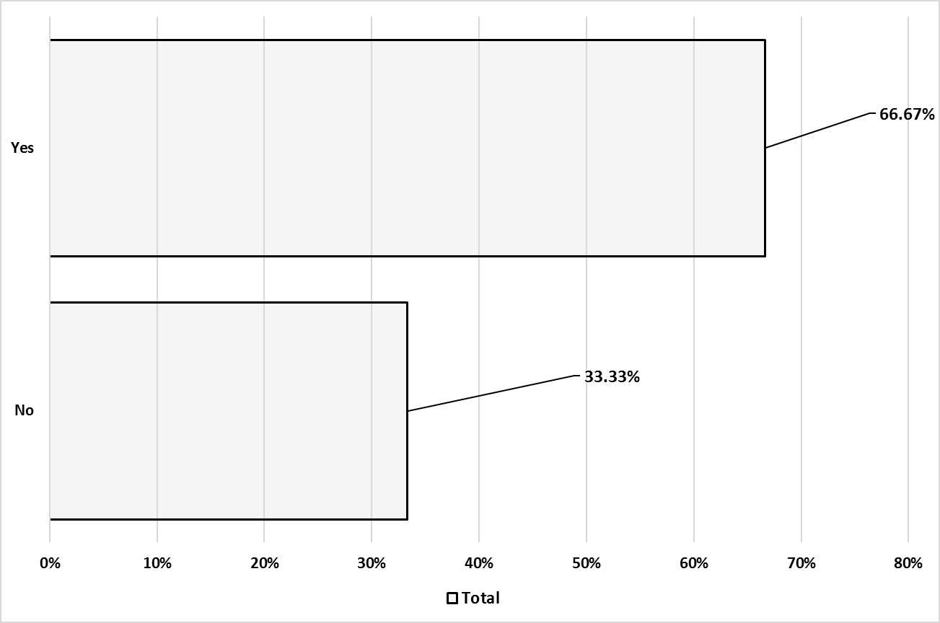
Results – College Now
Question:
During your high school education have you ever taken a College Now Course (a High School course for college credit)?
Follow up Question:
Which College Provided the Credit?
(Not Shown) Majority of responses were MHCC (93.24%)
Notes:
Springwater: Much lower proportion have taken a College Now Course

Slide 13
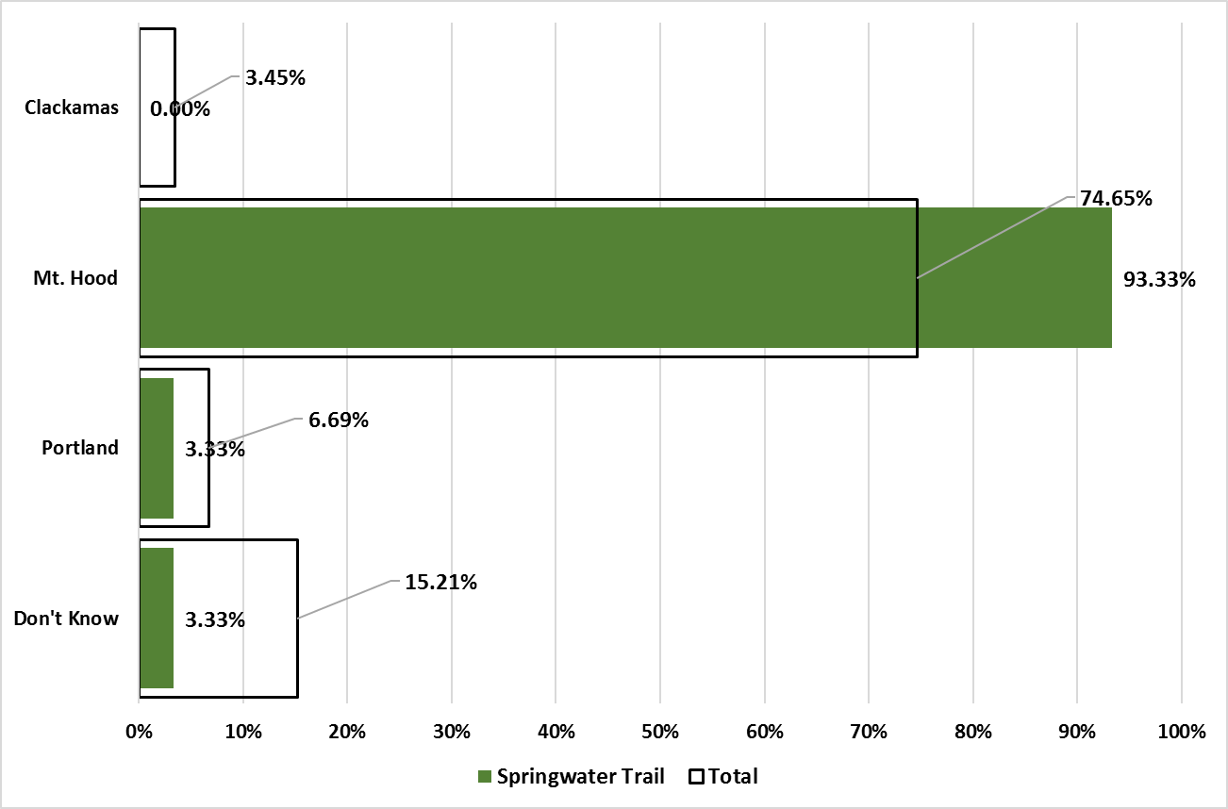
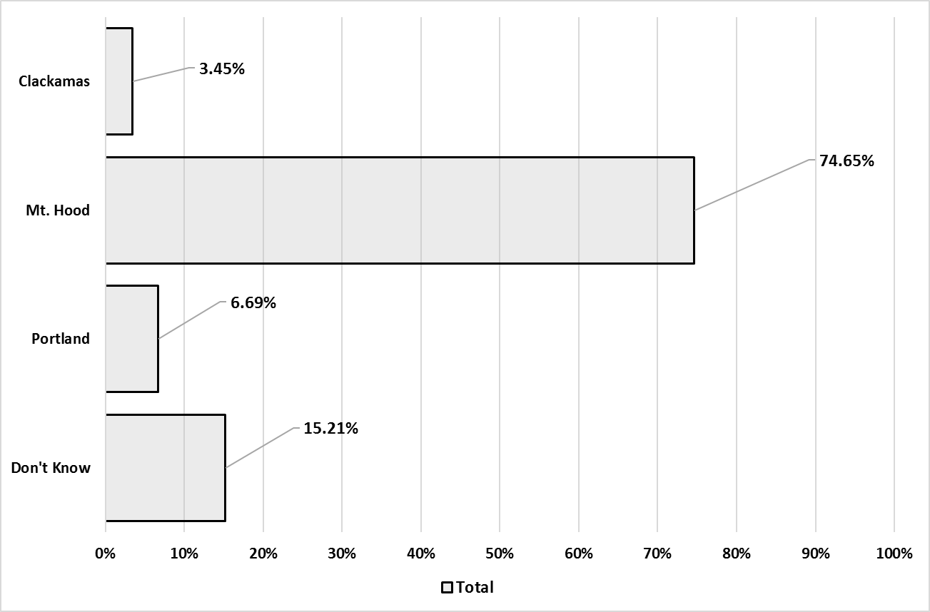
Results – Community College District Residence
Question:
In which community college district do you reside?
Notes:
Centennial: A much lower proportion of Centennial Seniors identified MHCC as the district they reside in.
Seniors were more likely to identify Portland Community College or indicate they did not know.
Springwater: A higher proportion identified MHCC as the district they reside in.
Sandy: A higher proportion identified MHCC as the district they reside in.
A higher proportion identified Clackamas as the district they reside in.

Slide 14
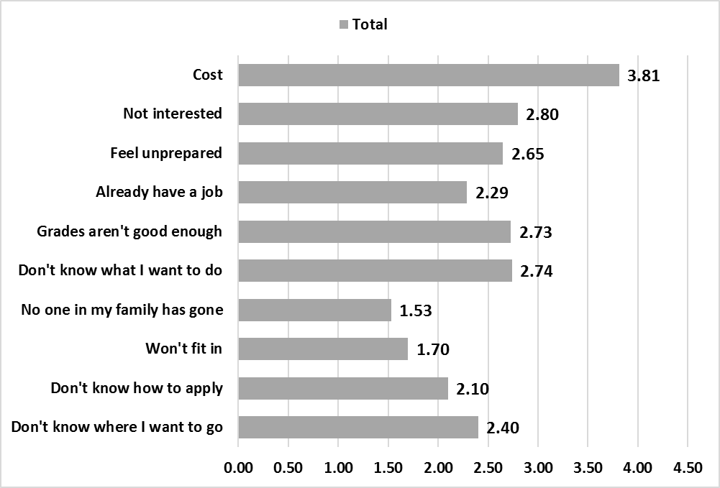
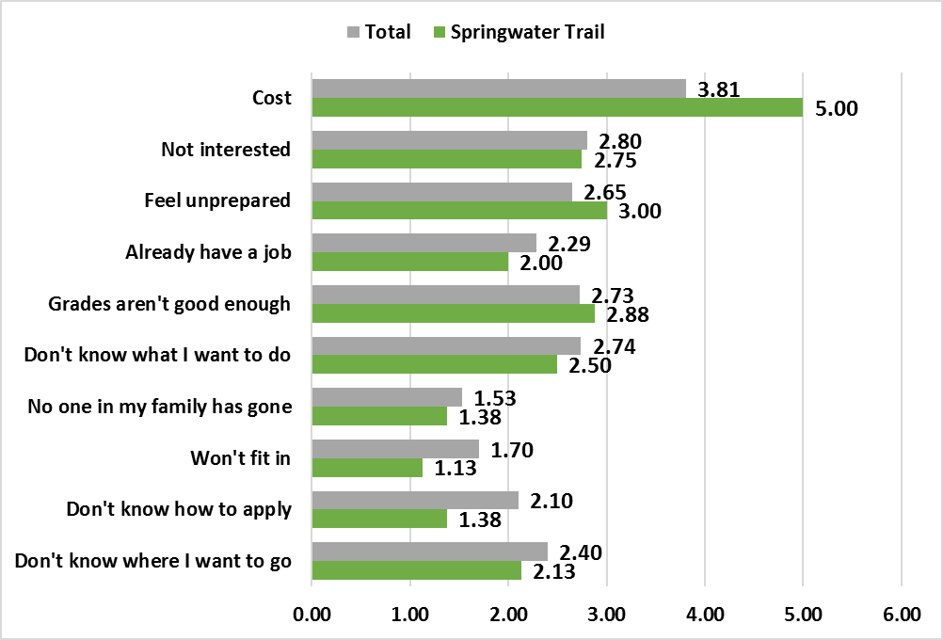
Results – Not Continuing Education: Reasons
Mean Scores for Reasons for Not Continuing Education
Question:
Listed below are a number of reasons for NOT going to college/university. Please indicate whether each is a minor or major reason for you deciding not to continue your education by clicking the appropriate level.
7-point scale (1=Not a Reason at All to 7=Extreme Reason)
Notes:
Total:
Cost was overwhelmingly the biggest reason for not continuing education
The perception that seniors feel unprepared and grades were not good enough were the second and
third highest reasons.
Springwater: Much more likely to indicate Costs and Feel unprepared
Much less likely to indicate they Won’t fit in and Don’t know how to apply

Slide 15
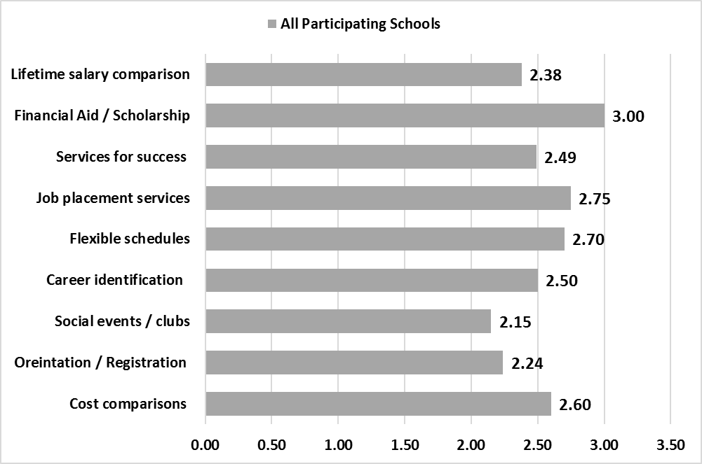
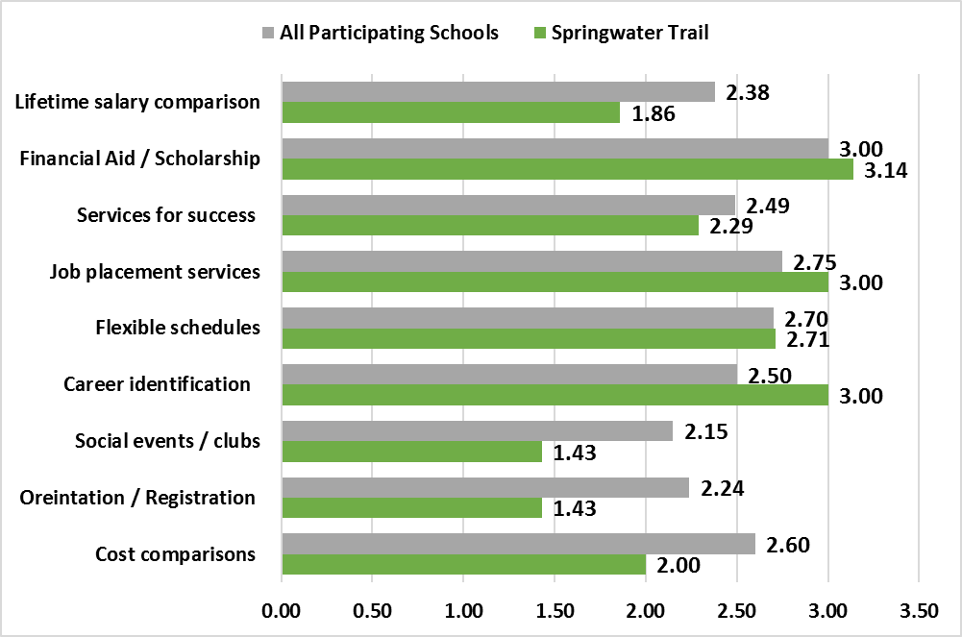
Results – Not Continuing Education: Information
Mean Scores for Information that may Increase the Likelihood of Continuing Education
Question:
Listed below are information and services that could be available from any college/university. For each, please indicate if it would impact the likelihood of your continuing your education by checking the appropriate level.
7-point scale (1=Not Change to 7=Dramatic Increase)
Notes:
Total:
Financial Aid/Scholarship Information was the most influential source. Job Placement Services was second highest rated.
Flexible schedules was the next highest rated information source.
Springwater: Career Identification Services was rated much higher than the overall. Job placement Services and Financial Aid /
Scholarship were also rated higher. All others were rated much lower than the overall.

Slide 16
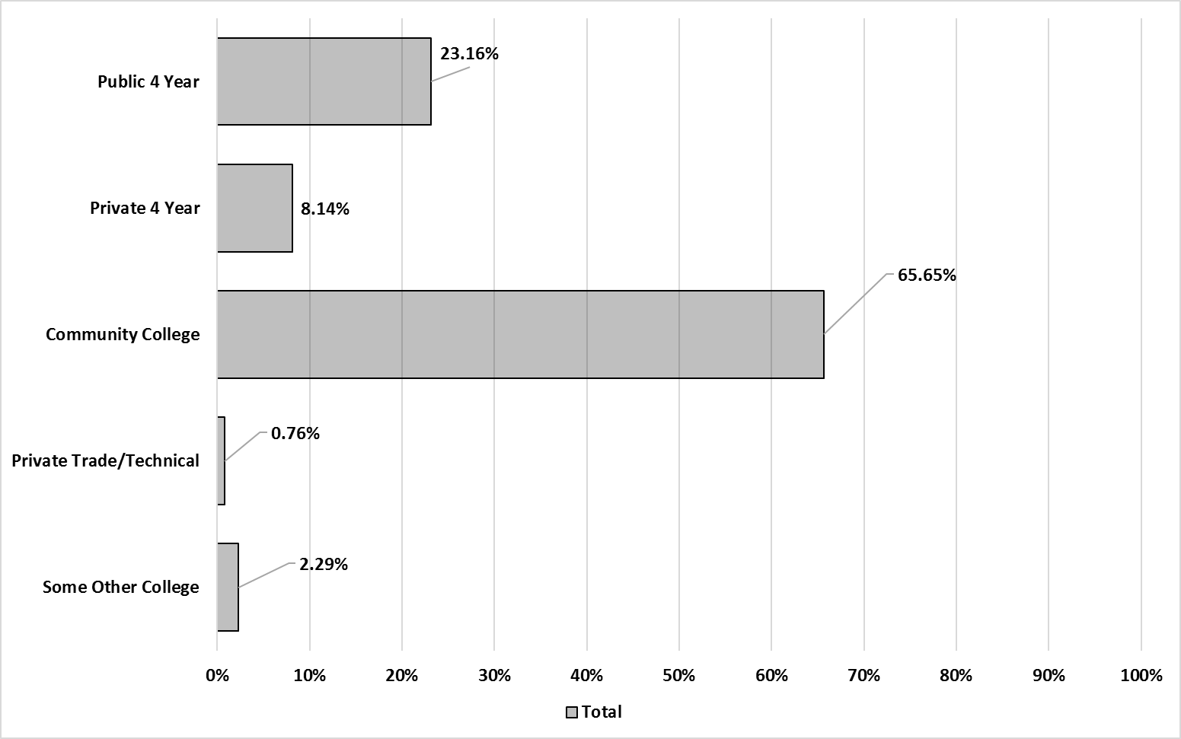
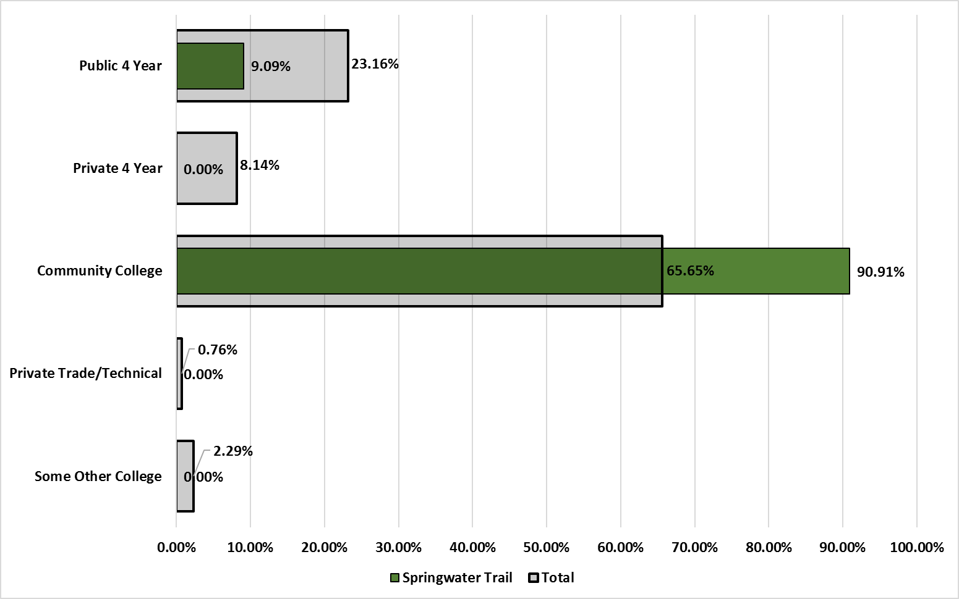
Results – Continuing Education: Institution Type
Question:
Where are you planning to continue your education? Please check the type of institution that most accurately describes where you will be attending school.
Notes:
Total:
The majority of seniors (2/3’s) will go to community college
Almost quarter will attend a public 4-year institution
Eight percent will attend a private 4-year institution
Springwater: A substantially higher proportion of seniors will go to a community college.
Lower proportions will go to any other type of institution.

Slide 17
Results – Cont. Education: Reason for Selecting
Question:
Listed below are major reasons students choose a particular campus. For each reason, please let us know how important it was in your decision to select the institution you are attending by checking the appropriate box.
7-point scale (1=Totally Unimportant to 7=Totally Important)

Slide 18
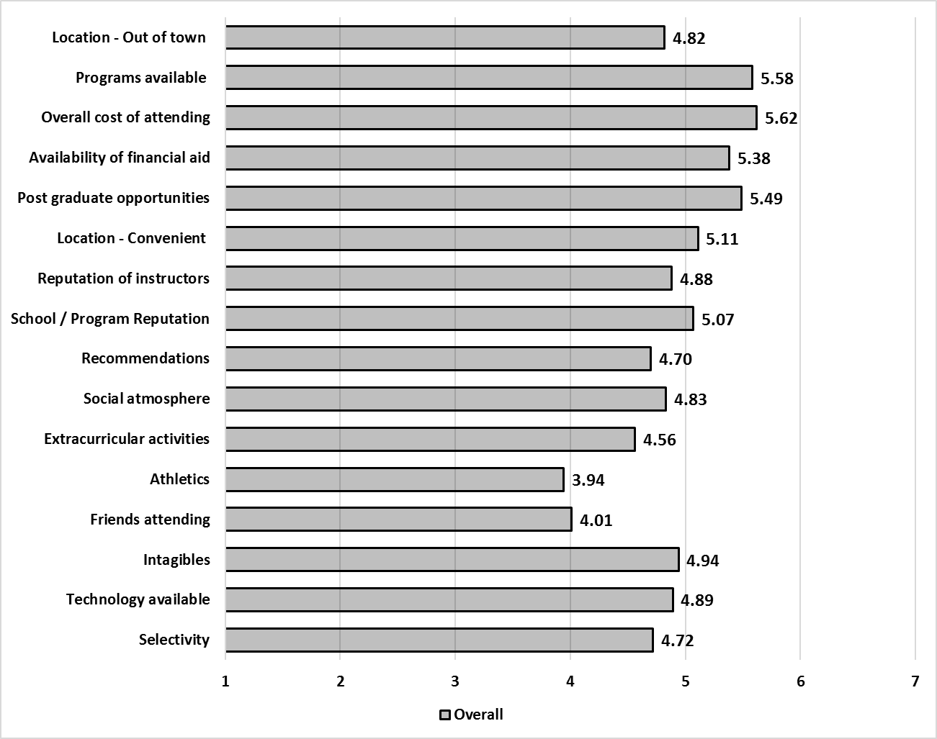
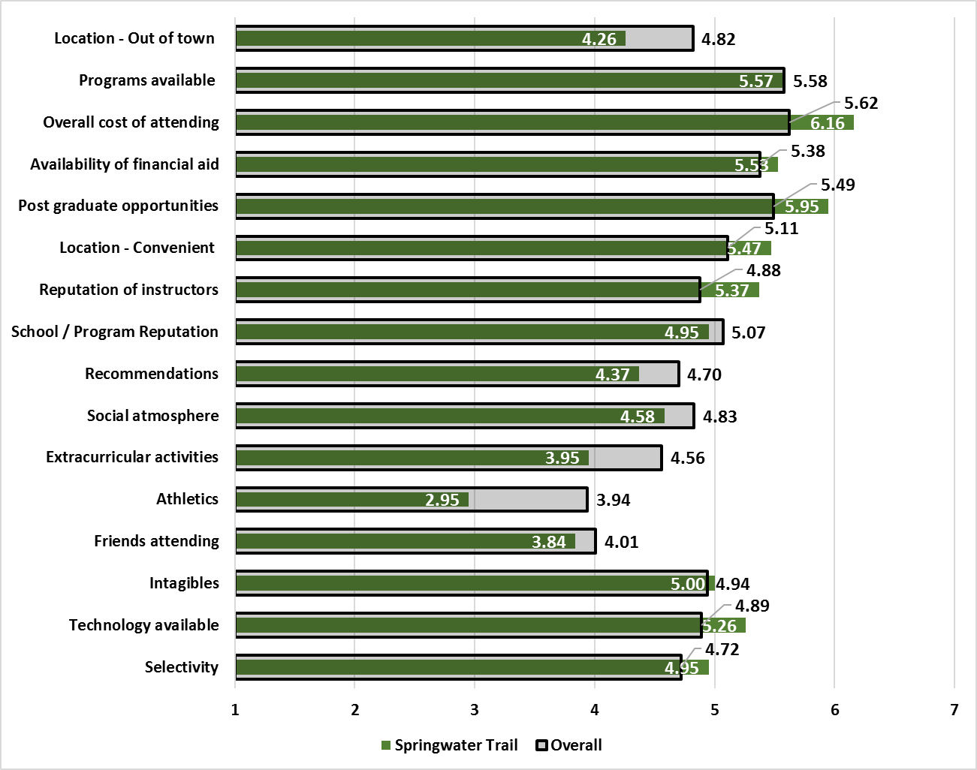
Results – Cont. Education: Reason for Selecting
Mean Scores for Reasons Students Choose a College/University
Total
SpgT.
Location – Out of Town
4.82
4.26
Programs Available
5.58
5.57
Overall Cost
5.62
6.16
Financial Aid Avail.
5.38
5.53
Post Grad Opps.
5.49
5.95
Location - Convenient
5.11
5.47
Reputation - Instructors
4.88
5.37
Reputation - School
5.07
4.95
Recommendations
4.70
4.37
Social Atmosphere
4.83
4.58
Extracurricular Acts.
4.56
3.95
Athletics
3.94
2.95
Friends Attending
4.01
3.84
Intangibles
4.94
5.00
Technology Available
4.89
5.26
Selectivity
4.72
4.95
Notes:
Total Highest rated reasons for selecting
- Programs Available of interest to me
- Overall cost of attending
- Availability of Financial Aid
- Post Graduate Opportunities (Likelihood of getting a job)
Springwater: Overall Cost of Attending, Reputation of Instructors, Technology Available, Post Grad Ops, and Location – Convenient
were rated higher by Springwater Trail Seniors.
Athletics and Extracurricular Activities were rated lower.

Slide 19
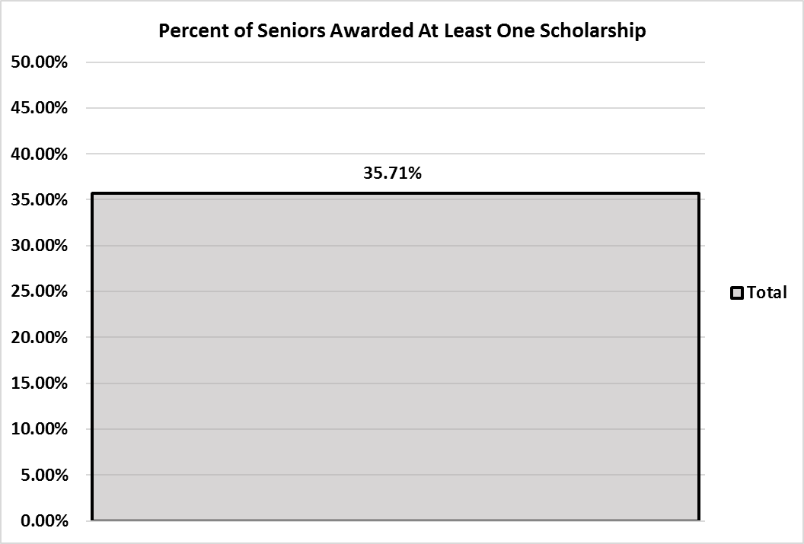
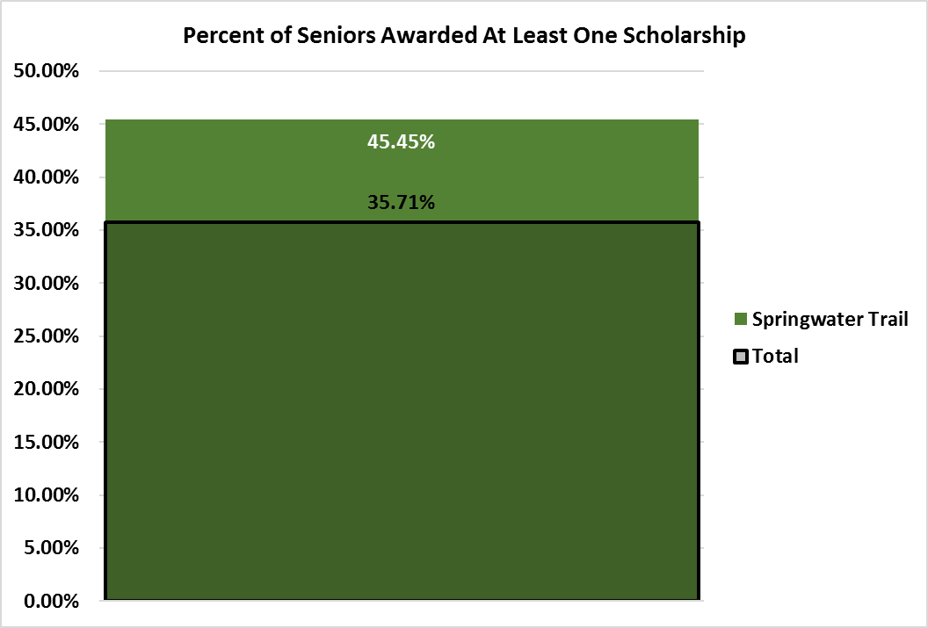
Results – Cont. Education:
Scholarships
Notes:
Overall, about 1/3 of seniors continuing their education were awarded at least one scholarship.
Centennial: Slightly lower proportion of Centennial Seniors were awarded a scholarship
Springwater: Higher Proportion of Springwater Trail Seniors were awarded a scholarship
Sandy Slightly higher proportion of Sandy Seniors were awarded a scholarship

Slide 20
Results – Continuing Education: Institution Type
Question:
Where are you planning to continue your education? Please check the type of institution that most accurately describes where you will be attending school.
Notes:
Total:
The majority of seniors (2/3’s) will go to community college
Almost quarter will attend a public 4-year institution
Eight percent will attend a private 4-year institution
Springwater: A substantially higher proportion of seniors will go to a community college.
Lower proportions will go to any other type of institution.

Slide 21
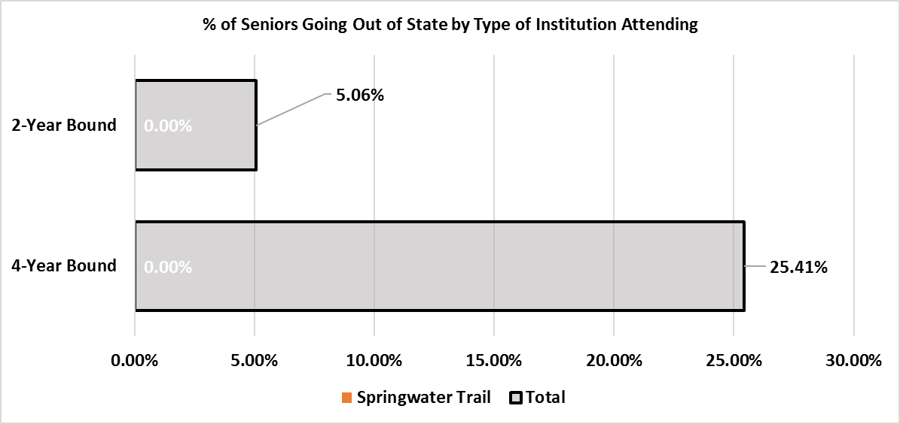
Results – Cont. Education: In-State vs. Out-of-State
No Springwater Trail Seniors are heading out-of-state.
Notes:
A quarter of all seniors heading to four-year institutions are going out of state.
About five percent of seniors heading to 2-year institutions are going out of state.
Springwater: No seniors are heading out of state

Slide 22
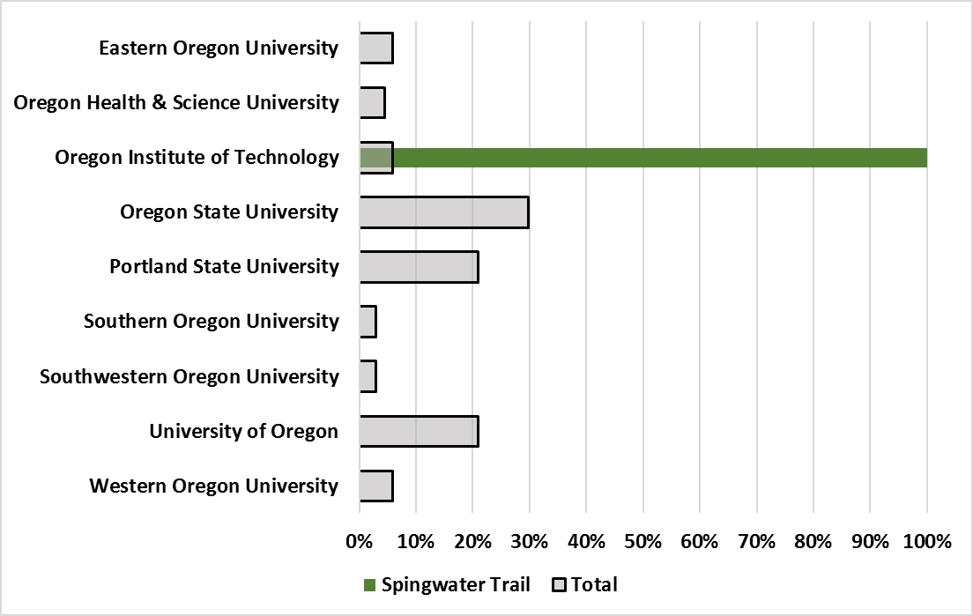
Results – Cont. Education: 4-Year Public University
Notes:
For Public 4-Year Institutions
The majority of Seniors are going three institutions:
-Oregon State
-Portland State
-University of Oregon
Springwater: One Senior will attend a 4-year Public University: OIT

Slide 23
Results – Cont. Education: 4-Year Private University
No Springwater Trail Seniors are attending 4-Year Private Universities
Notes:
Overall, a very small number of students going to Private 4-year Universities (1 each to seven of the fourteen identified).
Springwater: No seniors indicated they will attend a Private 4-Year University.

Slide 24
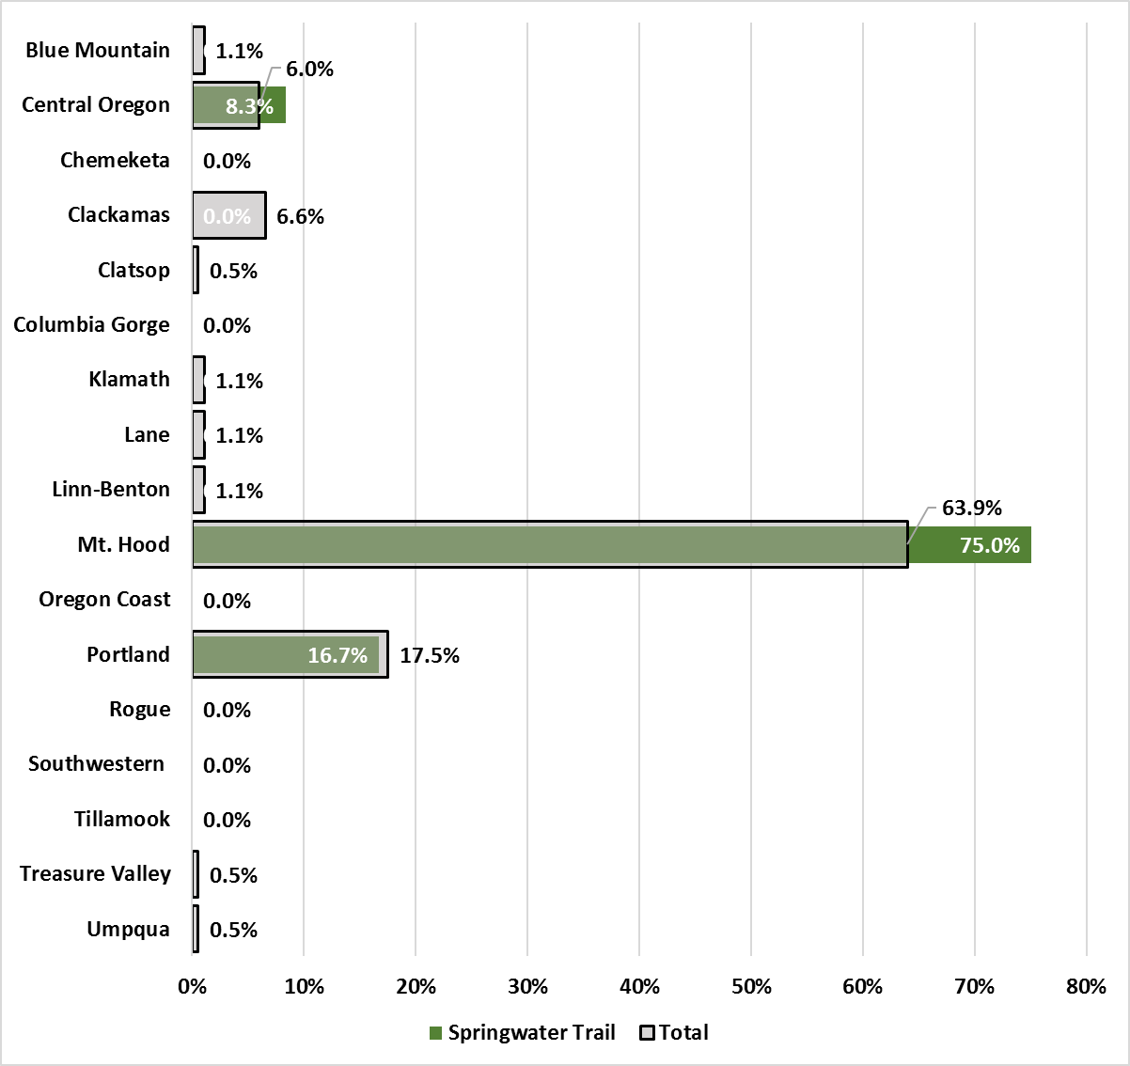
Results – Cont. Education: Community College
Notes:
Total:
The majority of students going to community college have indicated they will go to MHCC.
Springwater: The Proportion going to MHCC is higher than the total.

Slide 25
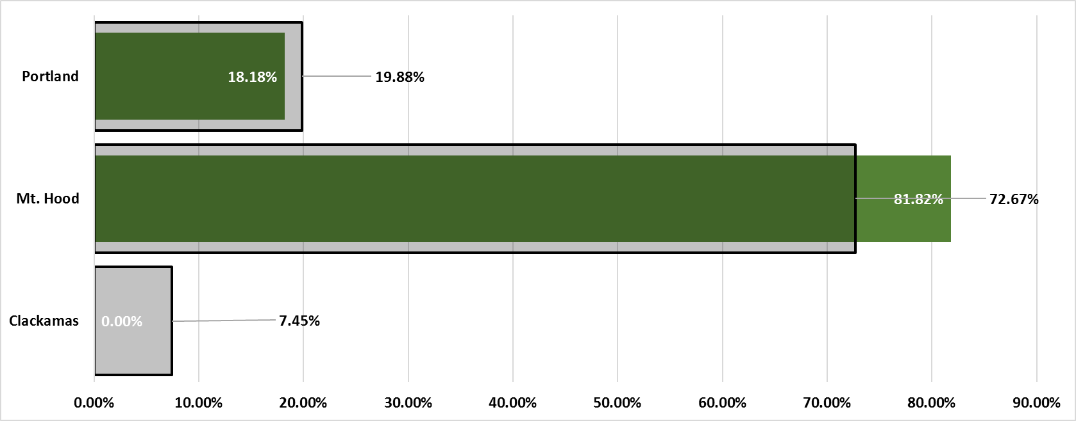
Results – Cont. Education: Community College
Seniors Attending Portland Metropolitan Community Colleges
Notes:
When looking only at those attending a Portland Metropolitan Community College, over a quarter (27.33%) are attending one of the other two institutions.
Springwater Trail - A much higher proportion of Springwater Trail Seniors are attending MHCC than seniors overall.

Slide 26
Results – Cont. Education: Private Trade/Technical Colleges
No Springwater Trail Seniors indicated an intent to attend a Private Trade/Technical College
Notes:
When looking only at those attending a Portland Metropolitan Community College, over a quarter (27.33%) are attending one of the other two institutions.
Centennial:
More than 2/3’s (37.21%) are attending one of the other two colleges. A much higher proportion are attending PCC.

Slide 27

Springwater Trail Custom Questions

Slide 28
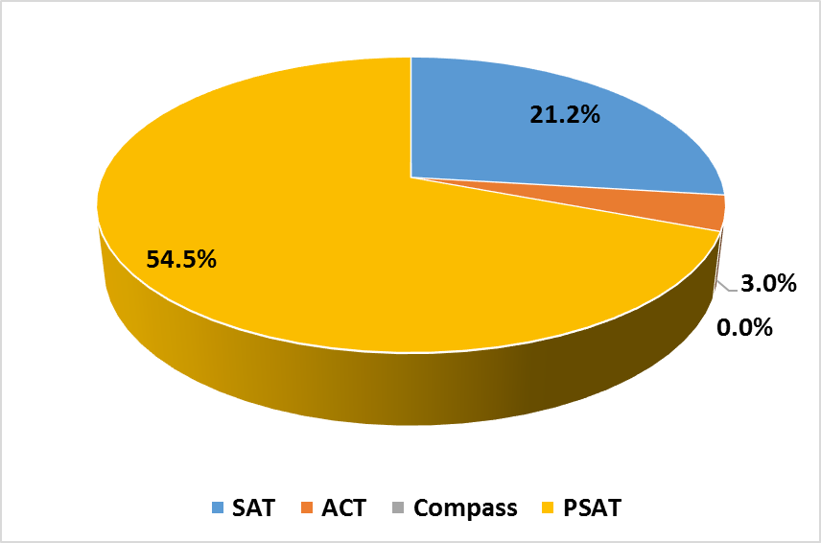
College Placement Tests

Slide 29
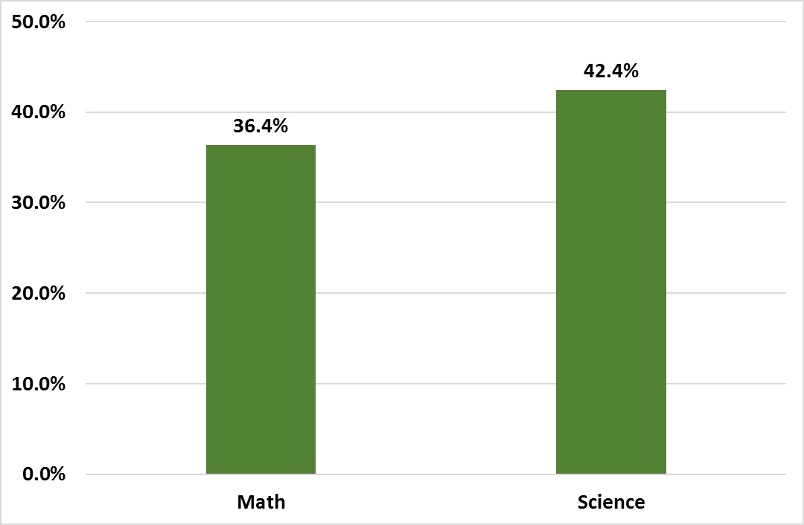
4th Year Math and Science Coursework

Slide 30
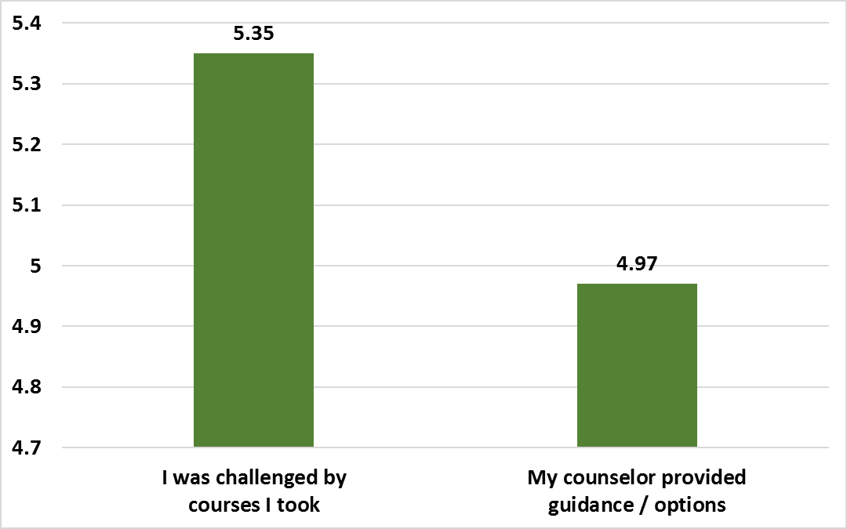

Slide 31
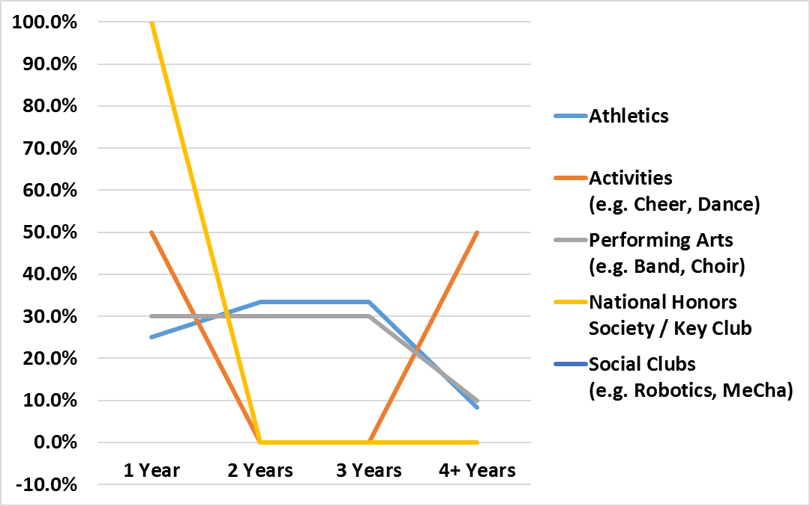
Activity Participation

Slide 32
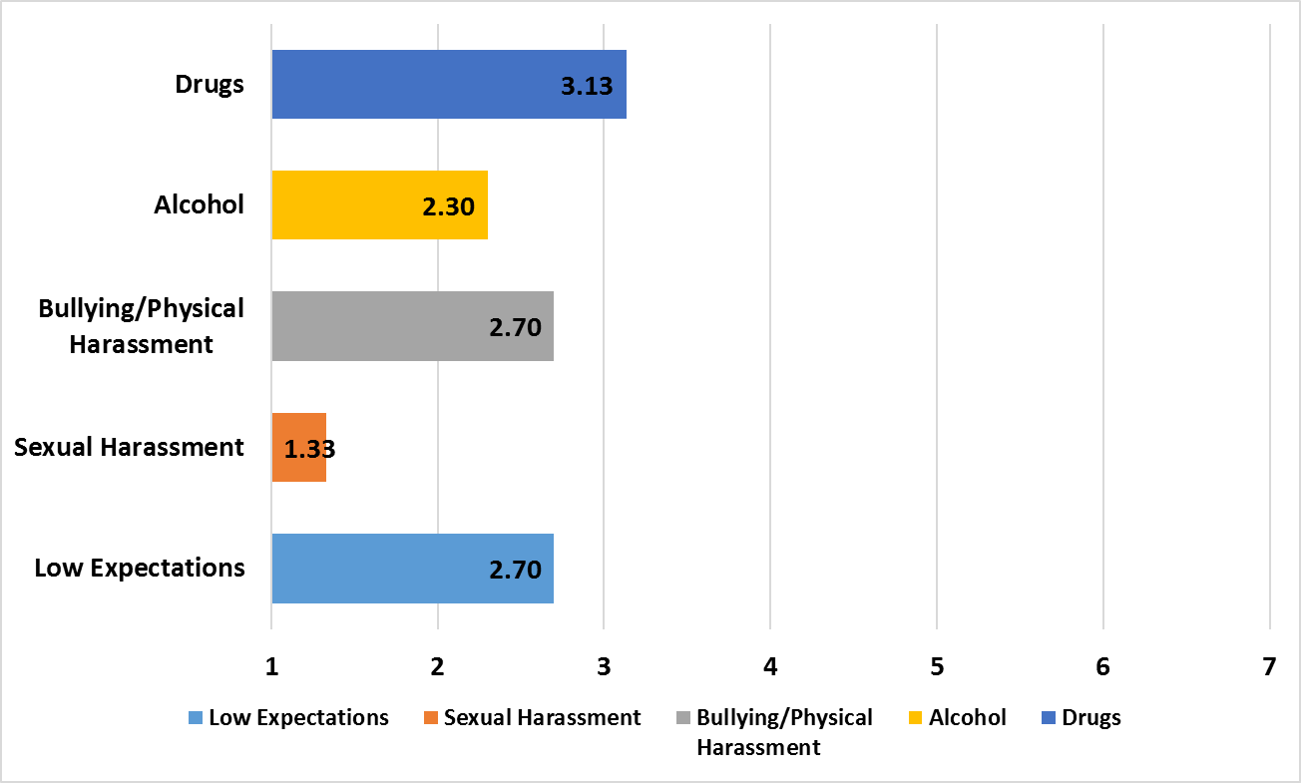
Issues on Campus

Slide 33
Conclusions / Recommendations
For MHCC
Make sure Springwater Trail Seniors are aware of the resources available to them through MHCC. Communication between the college and Centennial’s administration and counselors is critical.
Capitalize on information content (both for seniors continuing education and those not continuing) to develop messages that will influence decisions.
Survey needs to be repeated annually. Increase High school participation.

Slide 34
Conclusions / Recommendations
For Springwater Trail
Make sure Springwater Trail Seniors are aware of the resources available to them through MHCC. Communication between the college and Springwater Trail administration and counselors is critical.
Capitalize on information content (both for seniors continuing education and those not continuing) to develop messages that will influence decisions.
Survey needs to be repeated annually.

